Slide 1

WELCOME!!
WELCOME!
Notes:
IF YOU CAN SEE THIS ON THE CALL, WE NEED TO SWITCH INTO PRESENTER MODE

Slide 2

Shut the Front Door!
Cypurr Collective
September 2020
Exp. Date 11/20
Notes:
Feel free to change/delete/add any slide, any amount, I will not care... this is just to create some kind of structure… almost like… it’s as if it were… some kind of… tem… plate…?? If that were a thing?

Slide 3
Who are we?
We are…
The Cypurr Collective: A group of folks that organize cybersecurity events, looking to spread knowledge and talk about privacy rights!
Established April 2016
3-4 cryptoparty, discussion, and social events every month in NYC!
Just some folks interested in making safer spaces for others to talk bout their privacy needs

Slide 4
A few rules for this workshop …
Share the space - Step Up Step Back: Ask a question, give a comment, leave room for others to speak
Stack! - Raise your hand and we will put you on the speaking queue
Saf(er) Space - We DO NOT tolerate language or behavior purposefully meant to demean or harm folks based on their identities
No one should be forced to discuss their own experience/threat model/situation
Photo/Video - No photo/video without asking!
Bonus Rule - Try not to invalidate experiences!

Slide 5
A few rules for this workshop …
Share the space - Feel free to ask questions in the chat! Or, save them for the Q/A!
Stack! - If we’re asking for vocal discussion, please use the “hand” icon to let us know you’re interested in speaking b4 you unmute!
Saf(er) Space - We DO NOT tolerate language or behavior purposefully meant to demean or harm folks based on their identities a.k.a WE WILL BOOT ZOOM BOMBERS!
Photo/Video - Slides/Resources available after!
Bonus Rule- Be mindful of the Mute button!
...For Zoom!

Slide 6

Overview
Intro
What is Router?
Securing Your Front Door
Settings
Firmware
Firewall
Q&A
Outro

Slide 7
What is router?
What it do?

Slide 8
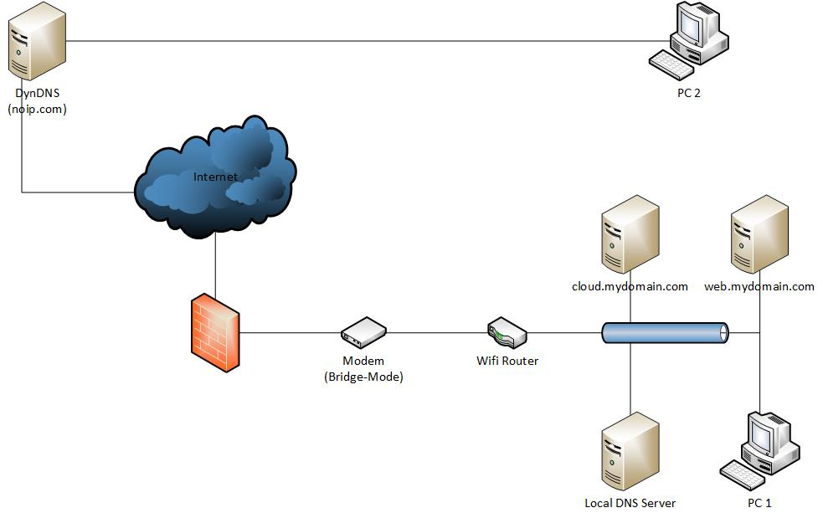

VERY PROFESSIONAL DIAGRAM
2
https://i.stack.imgur.com/AlLyr.jpg
Notes:
It’s the thing connecting the internet to your home network, and vice versa. It’s basically the front door to your house, digitally. (We probably need a less heinous pictures… I can try to draw one maybe, this is just a placeholder) THE FRONT DOOR IS A COMPUTER.

Slide 9
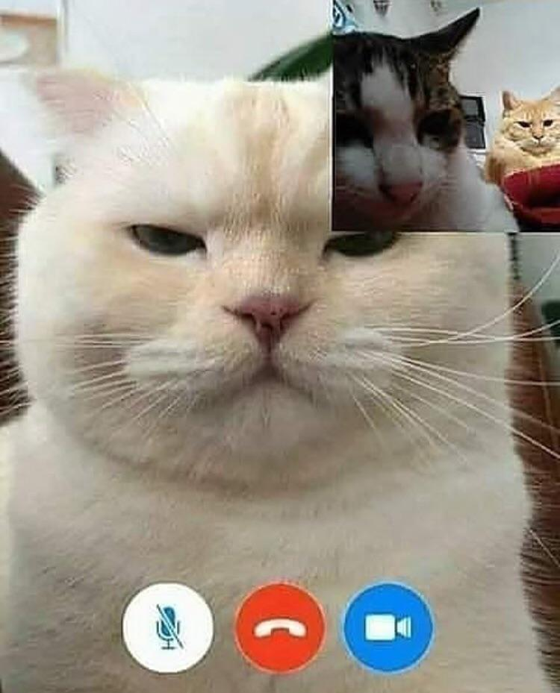
Leaving the Front Door Open

Slide 10
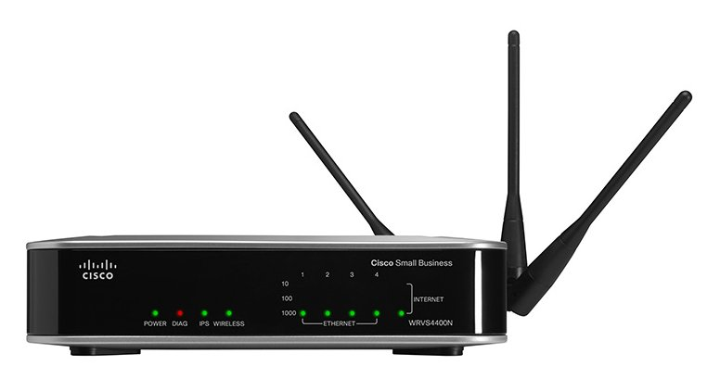
“Hackers infect 500,000 consumer routers all over the world with malware”
Dan Goodin, Ars Technica,
5/23/2018
Hackers possibly working for an advanced nation have infected more than 500,000 home and small-office routers around the world with malware that can be used to collect communications, launch attacks on others, and permanently destroy the devices with a single command, researchers at Cisco warned Wednesday.
Notes:
What do people know about router vulnerabilities?

Slide 11
Why is this important?
2
“Since the affected devices are legitimately owned by businesses or individuals, malicious activity conducted from infected devices could be mistakenly attributed to those who were actually victims of the actor.”
Notes:
For example, in a DDOS attack

Slide 12

How to Shut the Front Door
new username + pword
firmware updates!

Slide 13
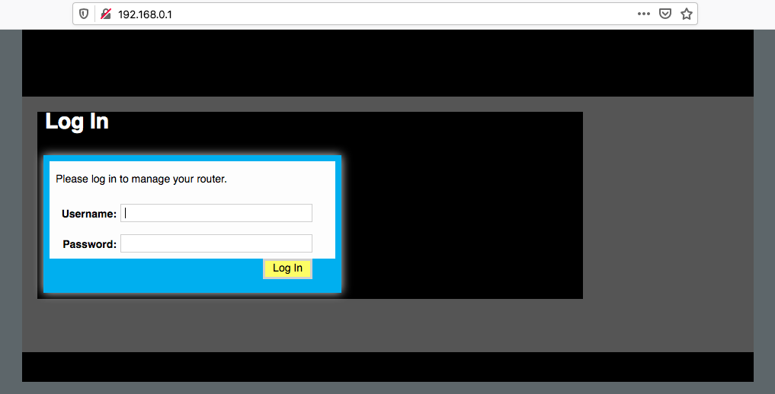
Go to your
Router
Dashboard
Usually here: 192.168.1.1 (but not always)
Click around the settings!
Notes:
So for both of these, you need to go to your router dashboard. On this computer it’s 192.168.0.1 -- you can google how to get to the router dashboard, it may not be this IP address -- it will be different depending on your OS and also your ISP. For example if you use Optimum, it will actually reroute you into a site they run.

Slide 14
Let’s do it
we’ll take 5 mins for everyone to look up “how to get to your router dashboard” and try to log in

Slide 15
How many devices are connected to your router currently?

Slide 16
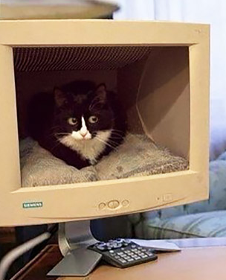
Firmware?
Firmwhat? Firmwho?
What is this word I never hear?
Notes:
software update vaccine analogy, standard botnets won’t be able to take advantage of your router

Slide 17
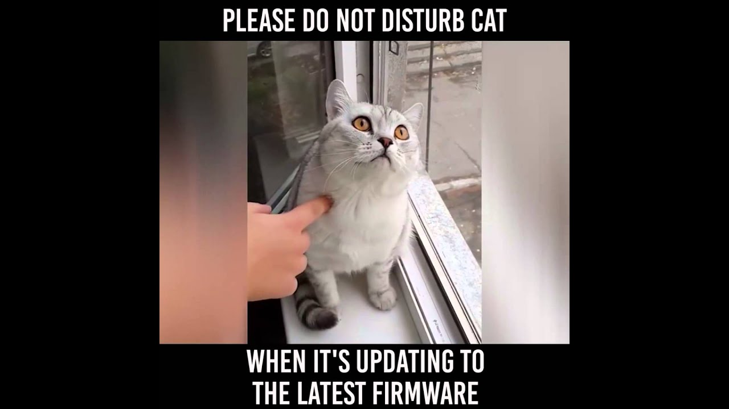
The only time you’ll ever have to deal with it
Why is it important to update the firmware?
all your traffic passes through the router
if there is a security vulnerability it’s critical to patch it
if your router can’t update, toss it and get another
some routers have automatic update functionality, which is safest

Slide 18
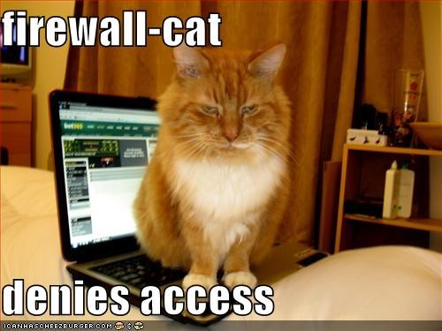
Firewall Basics
A firewall is a security-conscious router.
It sits between your Local Area Network (LAN), the network generally inside your home, and the outside world.
It can be configured to let traffic and out depending on your specifications.
Notes:
There are semester-long courses in this

Slide 19

Outro/Q&A
Notes:
AHHHHHH

Slide 20

Further Resources
Cypurr Collective - cypurr.nyc
Facebook @cypurrnyc
Twitter @cypurrnyc
cypurr@protonmail.com
EFF SSD - https://ssd.eff.org/
Tactical Tech Collective- Me and My Shadow
Hackblossom
Notes:
IF YOU CAN SEE THIS ON THE CALL, WE NEED TO SWITCH INTO PRESENTER MODE

